Slide 1
MSc Project
(CMP060L050S)
Mid-Point Review Presentation
Chronic Obstructive Pulmonary Disease detection using Deep Learning and StreamLit UI
Student Name:
Supervisor Name

Slide 2

Context
Chronic Obstructive Pulmonary Disease (COPD) is a serious lung condition that makes breathing difficult and often goes undiagnosed in early stages. Doctors may sometimes find it difficult to identify early symptoms of COPD.
This project uses deep learning to help detect COPD from medical images like chest X-rays.
A Convolutional Neural Network (CNN) is trained to identify signs of COPD, and the results are shown through a simple and interactive Streamlit web app. Users can upload images and instantly get predictions with visual explanations.

Slide 3
Problem Statement - WHY
COPD is hard to spot early because the symptoms aren’t obvious, so many people get diagnosed too late.
COPD is hard to spot early because the symptoms aren’t obvious, so many people get diagnosed too late.
Doctors may sometime find it difficult to identify early symptoms.
In rural or less-equipped areas, there aren’t enough specialists to properly diagnose COPD.
Reading chest X-rays takes experience and sometimes lead to mistakes or delays.

Slide 4
Objective - WHAT
To create an AI tool that helps detect COPD early by analysing chest X-rays.
A simple web app using Streamlit where users can upload X-ray images and get quick AI-based results, along with visual clues (heatmaps) showing problem areas.
This tool will help doctors save time, reduce missed diagnoses, and make COPD detection easier—especially in places with limited medical resources. It supports faster treatment and better care for patients.

Slide 5
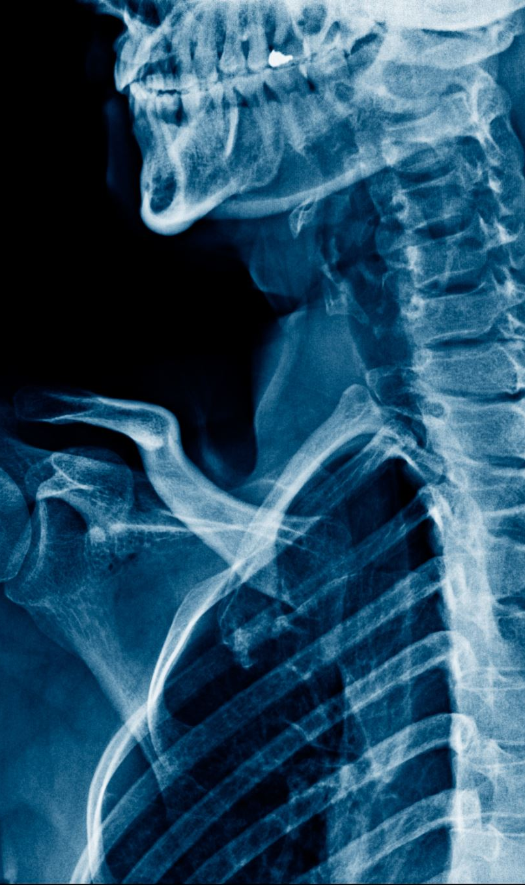
Methodology - HOW
Build a Streamlit web app so anyone can upload an X-ray and see results easily.
Use CNN (Convolutional Neural Network) to detect COPD from chest X-rays.
Train the model with open-source X-ray datasets (e.g., from Kaggle).
Build a Streamlit web app so anyone can upload an X-ray and see any results easily.
Add heatmaps to show which parts of the X-ray the AI is focused on.
Chose these tools because they are accurate, fast, and easy to use for doctors and non-tech users.

Slide 6
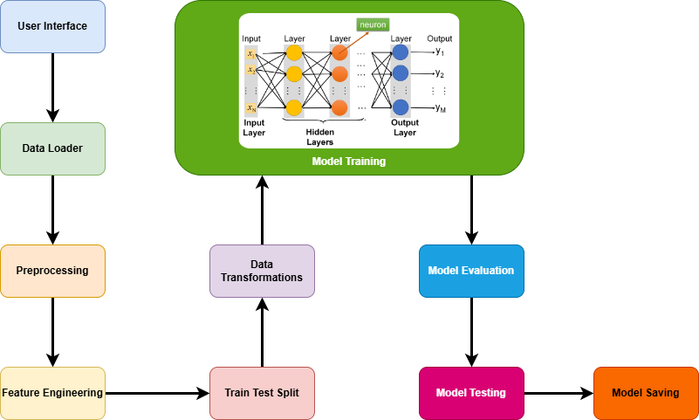
MODEL ARCHITETURE

Slide 7
Steps involved
User Interface – This is the front end where the user interacts with the system, whether it’s uploading data, configuring settings or triggering predictions.
Data Loader – Think of this as the intake valve. It pulls in the raw datasets, often from files, databases, or APIs, and feeds them into the pipeline.
Processing – Raw data is messy, Here’s where it gets cleaned up: missing values handled, outliers filtered, data normalised.
Feature Engineering – This step extracts or creates the most meaningful features from the data to improve model performance.
Train-Test-Split – The data is divided so part of it trains the model, and the other parts tests how well it learned.
Data Transformations - More technical shaping of the data—scaling, encoding, dimensionality reduction, etc. to ensure it's in just the right format for training.
Model Training - At the core is a neural network. Data flows in through input features (x₁ to xₙ), passes through hidden layers, and emerges as predictions (y₁ to yₘ).
Model Evaluation - This is where metrics like accuracy, precision, and recall help judge how good the model is.
Model Testing - The model is run against new, unseen data to test how well it generalizes beyond the training set.
Model Saving - Once the model passes evaluation, it’s stored and ready for deployment or reuse.

Slide 8
Literature Review
Author(s) | Year | Data Type | AI Method Used | Accuracy / Result | Key Contribution
Patel et al. | 2024 | Cough Sounds | LSTM + CNN | High Accuracy (not stated) | Low-cost, audio-based detection approach.
Siddiqui et al. | 2023 | Ultra-Wideband Radar | Time/Frequency Analysis | High Detection Rate | Innovative radar tech for breath analysis.
Yin et al. | 2023 | Physiological Signals | Fractional-order Models | Strong Performance | Novel signal processing for severity evaluation.
Jiaxing Sun et al. | 2021 | CT Scans | Deep Learning (CNN) | AUC: 0.934; 76.4% classification | CT-based AI model for severity staging.
Arpan Srivastava et al. | 2021 | Breathing Sounds | CNN | 93% ICBHI score | Demonstrated accurate sound-based classification.
Dhar | 2021 | Clinical Records | Genetic Algorithm + Ensemble | Improved Classification | Multi-stage model with enhanced feature selection.
Gokhan Altan et al. | 2020 | Lung Sounds | Deep CNN | 93.67% Accuracy | Verified lung sounds for effective diagnosis.

Slide 9
How Proposed Model is Different From Others ?
Using CNN with Streamlit Web App for quick results and to maintain higher Accuracy (90-93%).
Using medical Records and X-ray datasets as data.
Using core Medical Parameters for COPD Detection like:
FEV₁ (Forced Expiratory Volume in 1 second) Key metric for lung function—lower values signal greater airway obstruction.
FVC (Forced Vital Capacity) Measures the total amount of air exhaled; used with FEV₁ to calculate the FEV₁/FVC ratio.
FEV₁/FVC Ratio Critical for diagnosing COPD. A value below 0.70 is typically indicative of airflow limitation.
Gold Stage clinical staging system
Smoking History etc.

Slide 10
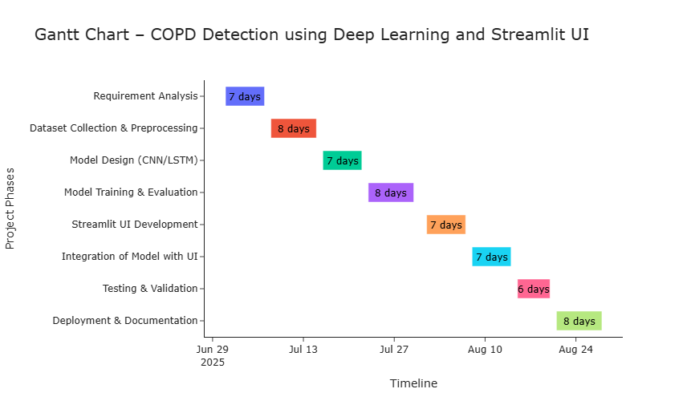
Project Management

Slide 11
CONCLUSION
Using deep learning to detect COPD can make diagnosing this serious lung disease faster and more accurate. By building a simple, easy-to-use app with Streamlit, doctors and patients can quickly get helpful results without needing complicated tools. This means people can get treated earlier, which can really improve their health and quality of life. While there are still some hurdles to overcome—like getting enough good data and making sure the system is trustworthy—combining AI with user-friendly apps is a big step forward in making healthcare smarter and more accessible for everyone.

Slide 12
REFERENCES
S. Minaee, R. Kafieh, M. Sonka, S. Yazdani, and G. J. Soufi, "Deep-COVID: Predicting COVID-19 from Chest X-Ray Images Using Deep Transfer Learning," IEEE Transactions on Medical Imaging, vol. 39, no. 8, pp. 2536–2545, Aug. 2020.
M. Anthimopoulos, S. Christodoulidis, L. Ebner, A. Christe, and S. Mougiakakou, "Lung Pattern Classification for Interstitial Lung Diseases Using a Deep Convolutional Neural Network," IEEE Transactions on Medical Imaging, vol. 35, no. 5, pp. 1207–1216, May 2016.
K. N. Bhat, P. S. Hiremath, and S. Nayak, "Deep Learning Based Lung Sound Analysis for Chronic Obstructive Pulmonary Disease (COPD) Detection," Proc. 2019 IEEE International Conference on Systems, Man and Cybernetics (SMC), pp. 1486–1491, Oct. 2019.
Streamlit Inc., "Streamlit — The fastest way to build data apps in Python," [Online]. Available: https://streamlit.io. [Accessed: 16-Jun-2025].
R. Sharma and A. Aggarwal, "AI in Healthcare: Predictive Models for COPD Detection," International Journal of Computer Applications, vol. 175, no. 25, pp. 1–6, Nov. 2020.

Slide 13

Thank You!

